Slide 1
How websites invade your privacy?
Dr Sharada Valiveti

Slide 2
introduction
Accessing website is not a solitary experience
Any site is capable of
Tracking the pages that you visit
Amount of time spent on each page
Tracking geographic location and place of work
Sites use this knowledge to deliver better information to you
Helps in profile creation
Three technologies are used
Cookies
Web tracking
Web bugs

Slide 3
technologies
Cookies
Bits of information put on hard disk when a particular website is accessed
Contain information like
Last time the page visited, the person's favourite sites etc.
Username and password of the user
Web bugs
Trace people's paths through a website
Web bugs can be included in email, and they can actually enable people to view some of your email

Slide 4
How cookies work?
Pieces of data placed on hard drive by server
Can store username and password
Can fill electronic shopping carts
Also store the name of site that store the cookies
Cookie information of one site can’t be shared with others
Location and files vary according to the type of computer and browser
When user visits a site, browser checks for cookie in hard disk
If found, sends information to server
Else, server places cookie file on hard disk
Credit card details are not stored in the cookies; but stored on secured server
Browser gives control to the user to keep cookies or not

Slide 5

How web bugs track you?
Piece of html code placed on web pages or emails to silently gather information, track their internet travels and allow creator of bug to read mails etc.
Email bugs can be created using html page only
It is mandatory to have html link in email
Web bugs can also be sent as gif files

Slide 6
Web bug
1
Web bug is placed in HTML code
2
Person inserts small piece of JavaScript code that reads the message content
3
Email when opened sends request to some server for sending the web bug (Clear gif)
Server knows the IP address of victim and sends Clear gif file
4
Server can read the email
If email is forwarded with some additional comments, even the comments can be read

Slide 7
How Websites track activities?
Sniffer analyses traffic
Using cookies
Open Profiling Standard (OPS) with browsers
Person’s IP Address
Sniffer examines packets as they come into and leave the site
Tracks who is making requests
Where they are coming from or going
Only the beginning and ending packets are necessary, other intermediate packets are discarded
Information is sent from sniffer to database
Server then analyses traffic

Slide 8
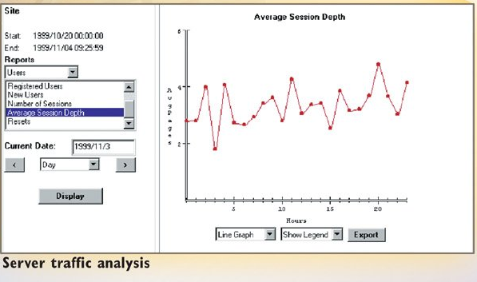
How Websites track activities?

Slide 9
How websites build personal profiles?
Form filling during registration process or initial sign-up
Cookies help in building profiles
Site examines user’s IP address and looks up about the IP address in database from a third party.
Can reveal geographic information
Place of work etc.
Sniffers and web bugs are also used
Website puts complete profile and sells information to advertisers or other websites or use it to customize ads and emails it sends to you

Slide 10
Thank you

